Slide 1
UTILITY | MIDWEST
Challenge
Ameren currently has about 10% of its applications in the public cloud with the rest of the applications in traditional datacenters. Cloud Operations is currently fragmented and part of the application teams across the organization and Ameren is looking for a POV on the leading practices in the industry. The organization would like to streamline its Operations, reduce its O&M cost and define a target state Operating Model
Solution
Identify anti-patterns to cloud operations and determine improvement opportunities and prescriptive solutions to different pillars.
Results
E2E visibility
Reduced TCO – licence
Cross-functional teaming & skill building
Decentralized decisions & Growth mindset
Focus on speed and agility
Copyright © 2024 Accenture. All rights reserved.

Slide 2

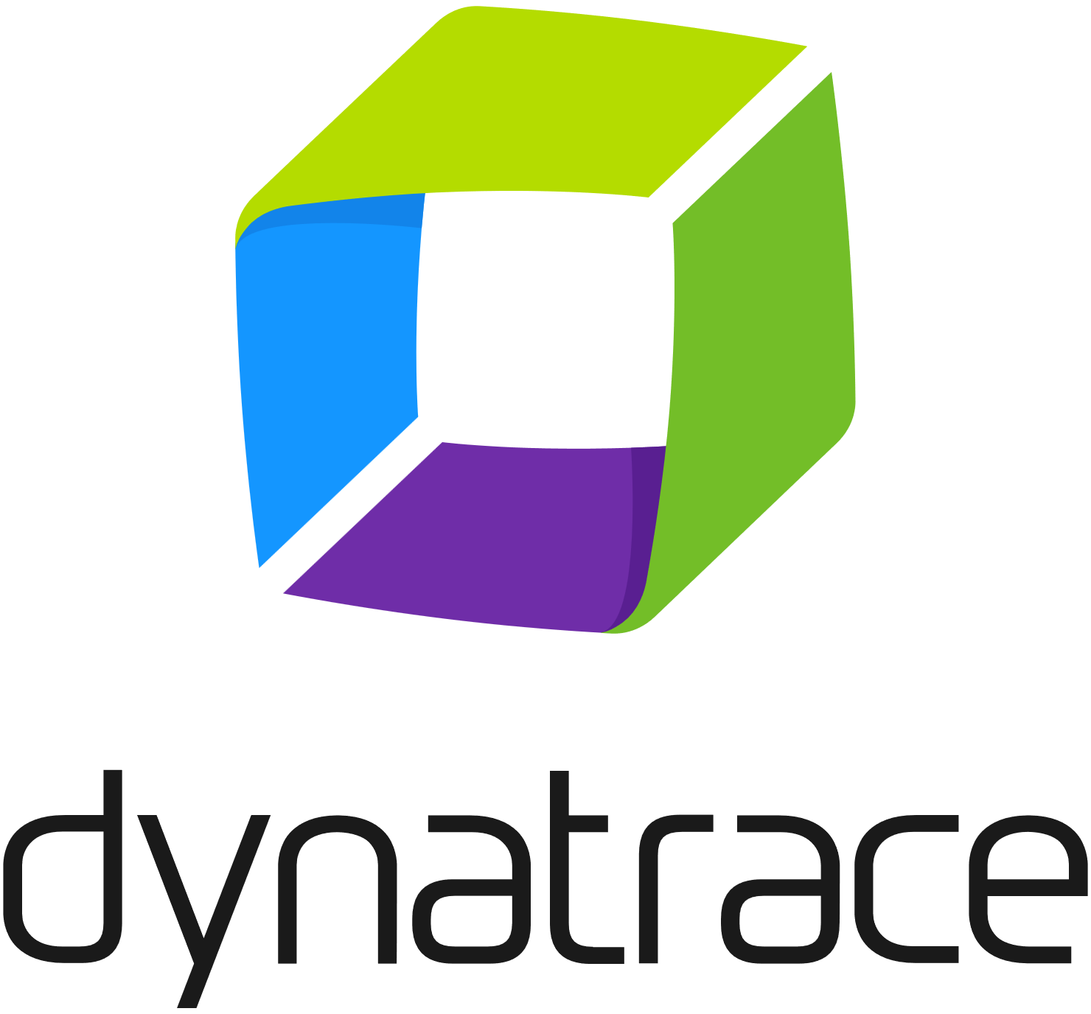

Monitoring & Observability
High Gap
Medium Gap
Low Gap
Capability Area | Description | People | Process | Tech
Infrastructure Monitoring |  | H | M | L
Network Monitoring |  | H | M | L
Application Monitoring |  | H | M | M
Dashboarding |  | H | H | H
Log Management |  | M | M | L
Tracing
Metrics
Tools
Alerting
Logging
API Gateways
Data pipelines
Serverless
Events
LB-Apps,
Databases
Containers
DNS, HTTPS, HTTP
SLOs SLIs MTTR
Outcomes
Monitor the security of all layers of your cloud environment: infrastructure, hosts, containers, and applications
Customize data & views for most impactful info for personas, teams, app,
Command center overview of metrics and context during triage
Analytics for trends and anomalies/outliers
Provide a self-service monitoring platform to enable team agility
Visualization
Copyright © 2024 Accenture. All rights reserved.

Slide 3



Security
High Gap
Medium Gap
Low Gap
Capability Area | Description | People | Process | Tech
Network Security
Endpoint Security
Platform
IAM
Compliance Management
Endpoint Security
Cloud
Secrets
IAM
API Gateways
SSO, MFA
Identity Compliance
Vendor Access
Secrets Vault
Endpoint
Cloud Access
Outcomes
Compliance & Governance
Zero trust
Access control for multi-cloud
Rapid onboarding vendors, contractors, employees
VPN augmentation
Continuous monitoring & validation
Least access privilege
Microsegmentation breaking up security perimeters into small zones to maintain separate access for separate parts of the network
Streamline compliance & minimize risk
Access Management
Copyright © 2024 Accenture. All rights reserved.

Slide 4



IT Service Management
High Gap
Medium Gap
Low Gap
Capability Area | Description | People | Process | Tech
Service Management
Service Desk
Reporting & SLA Management
Dashboarding
Log Management
Dashboarding
Reporting & SLA Management
Log Management
Service Desk
Site Recovery
Service Request Management
Incident Management
Problem Management
Change Management
Release Management
Service Continuity Management
Service Asset and Configuration Management
Outcomes
Streamline service management and minimize disruptions
Increase agent efficiency. Put time back into your agents’ day by empowering
Grid Management
Service Management
Reporting and Dashboarding
Service level Management
Incident Management
Knowledgebase
Service Catalog
Service Request
Copyright © 2024 Accenture. All rights reserved.

Slide 5




Architecture & Design
High Gap
Medium Gap
Low Gap
Capability Area | Description | People | Process | Tech
API Management
Cloud control Plane
Software Installation
Cross platform trouble shooting
Data Recovery and Back up
Mobile Applications
Outcomes
Control plane portal for self-service for tracking and organizing ways of working for teams
Developer portal with API management
Standardized list of services authorized & consumed by organization.
Application Patch / Deployment
Delivery methodologies & techniques
Tools & environments
Architecture quality principles & techniques
Config & release management
Software / Operating system issues
Copyright © 2024 Accenture. All rights reserved.

Slide 6
Service Operations
High Gap
Medium Gap
Low Gap
Capability Area | Description | People | Process | Tech
Software Installation
Cross platform trouble shooting
Data Recovery and Back up
Mobile Applications
Outcomes
fghfghjfg
Application Patch / Deployment
Software / Operating system issues
Copyright © 2024 Accenture. All rights reserved.

Slide 7
Legends
Each capability / sub-capability provides a description and a rating to indicate expected impact across people, process and technology for the client
The scoring given to each capability area is based, client documentation, stakeholder feedback and ACN industry experience to help drive a high-level analysis on the impact and complexity to mature the Cloud capabilities from a People, Process and Technology perspective for each capability area.
Legend – People, Process & Technology Impacts
Impact | People | Process | Tech
HIGH | Resource not in place, major skills or role changes within the organization. Significant change impact related to required talent | Major process change or new processes required | New technology stack required
MEDIUM | Minor skills or roles changes within the organization. Some change management effort | Minor process changes to existing processes required | Enhancement to existing technology / tools
LOW | Little or no changes to the organization. No change management effort | Existing Process is sufficient | Existing technology available

Slide 8
Case Studies
In Accenture we have implemented Splunk based solution across 200+ clients in different business areas and in different technologies like SAP, Java/#net, Oracle etc. Some of the notable use cases are:
Client: Largest Public Sector Bank of India
Business Problem:
One of the large public-sector bank in India was facing high customer dissatisfaction rate in its mobile valet app. Customers where not happy because of delayed resolution to the incident raised for transaction failures. This was due to support team manually checking incident details in server logs to identify problem.
Splunk Solution:
Accenture team provided live interactive log mining system by installing Splunk Universal forwarders in the servers. Forwarders used to pull transaction information from group of 4 high availability servers on which Mobile Valet application was running. This Splunk application had user interface to search the incident details using interactive UI. Application helped support team to do the log analysis using UI provided by Splunk without manually checking the log files.
Outcome:
This solution reduced Root Cause Analysis(RCA) time by 80% as support team can get the problem details through UI and enabled Accenture team to reduce the ticket resolution time by 45%.

